Slide 1
Revelation 17 REDUX
Prophecy fulfillment in real time!

Slide 2
Revisiting Revelation 17...
The explaining of these prophecies was done in two sermons;
1st on 1/8/2022 "The Eighth Kingdom"
2nd on 1/15/2022
https://www.umapinesda.org/sermon-recordings/sermons-of-2022

Slide 3
The Thesis of those two sermons...

Slide 4
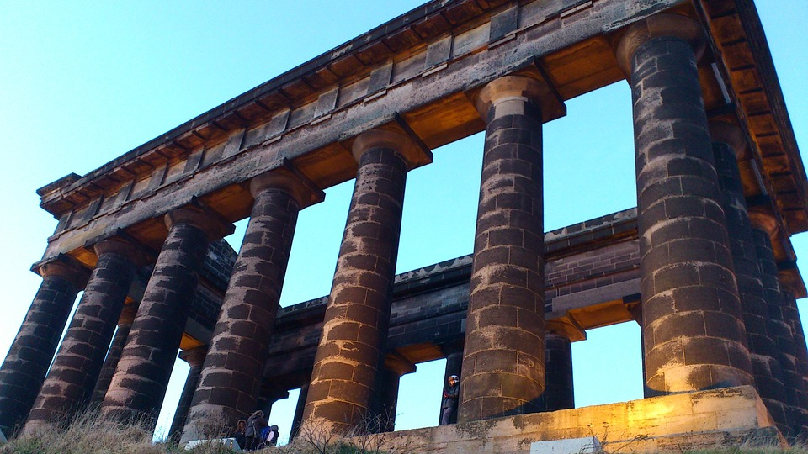
Established a point in History
The events that followed the seating of the Whore commenced when 5 empires holding universal sway, had passed from the scene of history
UPDATE.... regarding mountains
Rev17:9 + Dan 2:34,35

Slide 5
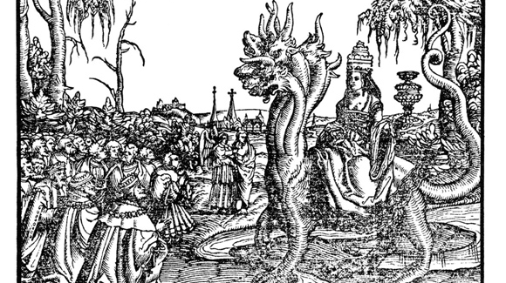
The Whore of Babylon Identified...
We saw that all the reformers rightly identified this woman as the Roman Papal system...
We established the incontrovertible fact that many of God's people are in association with that system either directly or through her harlot daughters... See Rev. 17:5
This Photo by Unknown author is licensed under CC BY-NC-ND.

Slide 6
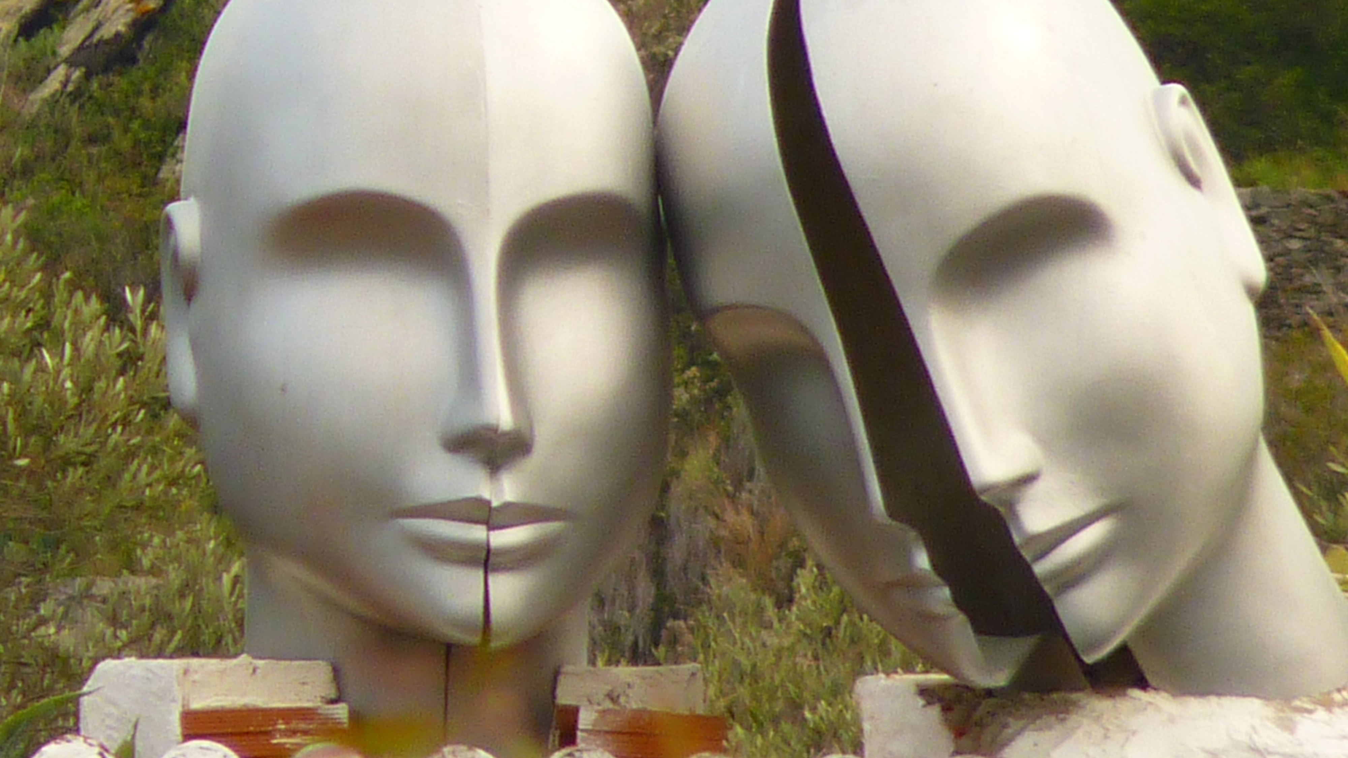
Two Heads... One is, and the other is not yet come...
The first head to be controlled was done so openly and was the domination of the apostate Christian Church from AD 538-1798, when the political power of the Papal system was suspended by Berthier, Napoleon Bonepart's general.

Slide 7
Two Heads... One is, and the other is not yet come...
The second head to be controlled was to be done, not openly, but secretly... In Isaiah 47, describing the overthrow of spiritual Babylon (A.K.A. the Papacy) it says "thou hast said, none seeth me." Isa 47:10

Slide 8
A universal puppet master
This Woman is Controlling the nations of this world on a universal scale; because the "Kings" or political systems of this world are in bed with her.
See Rev 17: 2
This Photo by Unknown author is licensed under CC BY-NC-ND.

Slide 9
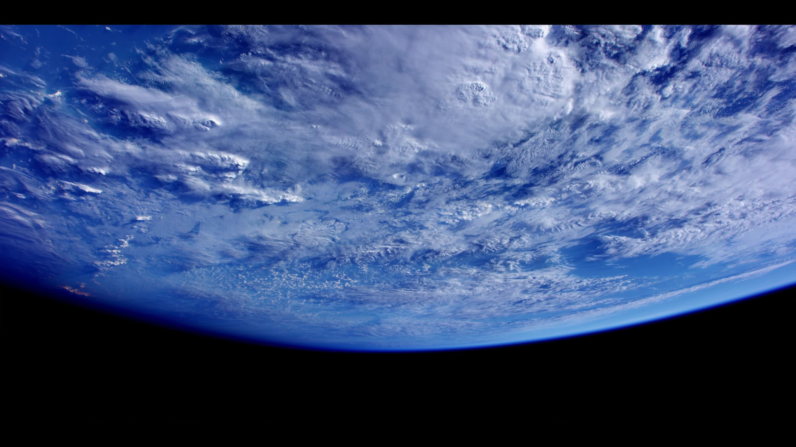
Have you noticed any kind of universal coordination on things lately?
This Photo by Unknown author is licensed under CC BY-SA.

Slide 10
The Beast excluding its heads (Kings)... = The Body Politic
This Photo by Unknown author is licensed under CC BY-NC-ND.

Slide 11
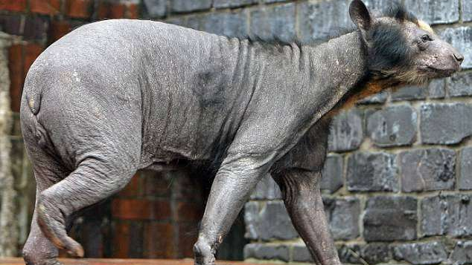
Fuzzy Wuzzy was a... republic...?
"The beast that was and is not and yet is"... and the beast that was and is not and shall ascend from the bottomless pit and go into perdition... Rev 17:8,11
See also Rev 11 and the French Revolution. Great Controversy Chapter 15
This Photo by Unknown author is licensed under CC BY-NC-ND.

Slide 12
Updates!
New Bible Verses incoming in support... but first...
This Photo by Unknown author is licensed under CC BY-NC-ND.

Slide 13
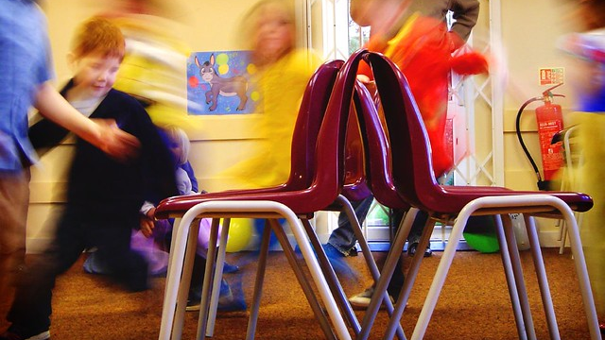
A Broken Game of Musical Chairs...
In Rev. 17 we only have one player and one chair... but the chair has two names... Stool and bucket.
This Photo by Unknown author is licensed under CC BY-NC-ND.

Slide 14
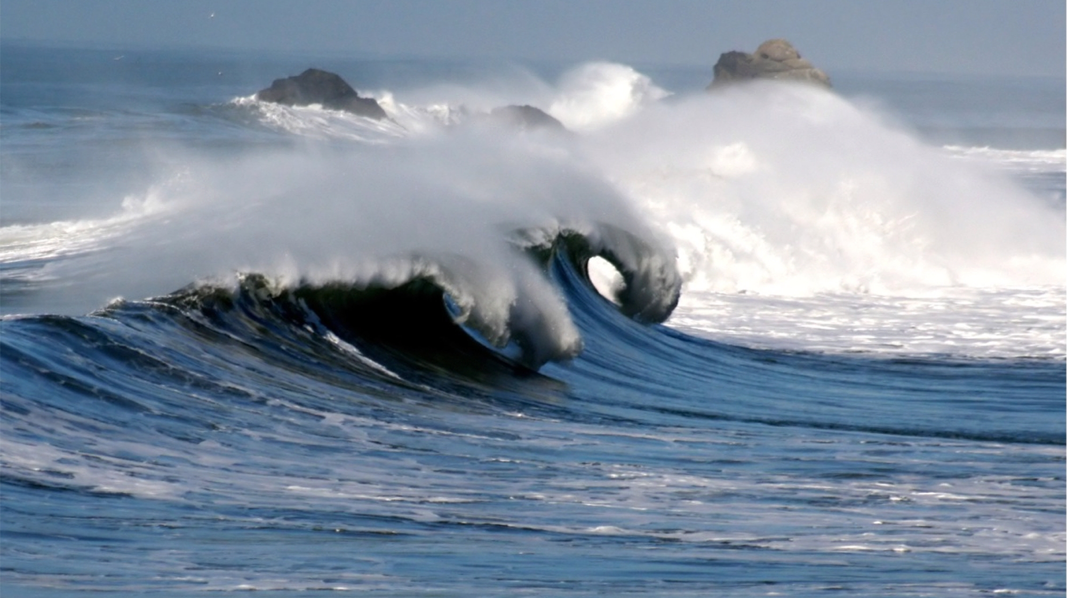
Jeremiah 51:42
The sea is come up upon Babylon: she is covered with the multitude of the waves thereof.
This Photo by Unknown author is licensed under CC BY-SA.

Slide 15
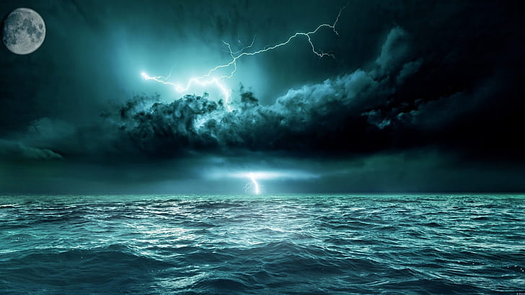
Jeremiah 50:41,42
Behold, a people shall come from the north, and a great nation, and many kings shall be raised up from the coasts of the earth. They shall hold the bow and the lance: they are cruel, and will not shew mercy: their voice shall roar like the sea, and they shall ride upon horses, every one put in array, like a man to the battle, against thee, O daughter of Babylon.

Slide 16
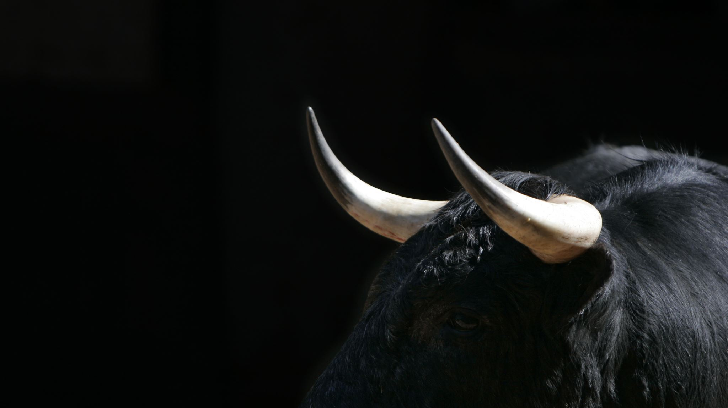
The Ten Horns... Rev 17:12,13
And the ten horns which thou sawest are ten kings, which have received no kingdom as yet; but receive power as kings one hour with the beast. These have one mind, and shall give their power and strength unto the beast.

Slide 17
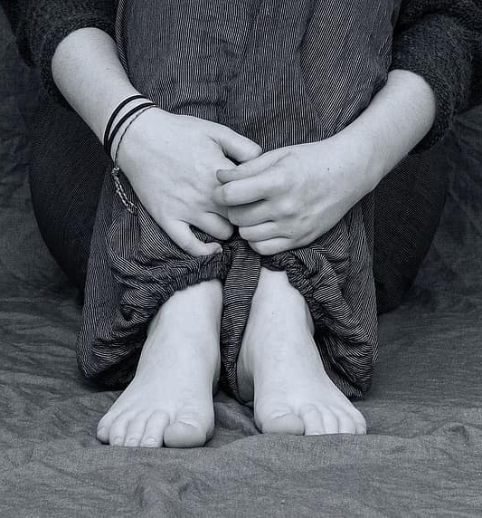
Rev 17:16... Trouble in the Whore's Paradise...
And the ten horns which thou sawest upon the beast, these shall hate the whore, and shall make her desolate and naked, and shall eat her flesh, and burn her with fire.

Slide 18
Synopsis
The apostate Papal Christian Church has since 538AD been in control of the political systems of this world, at first openly until 1798, now secretly , behind the scenes, controlling, universally, governments that are supposedly democratic republics. Through these pollitical lackeys, the peoples nations mutlitudes and tounges have been under her control...

Slide 19
...At the last hour political parties will arise who shall do the bidding of those who elected them and they and the people will hate the Whore and make her desolate, shall make her naked and shall eat her flesh and burn her with fire because God intervenes. (Rev 17:17)

Slide 20
Steps... Rev 17:16
Desolate, Naked, eaten, and burnt

Slide 21
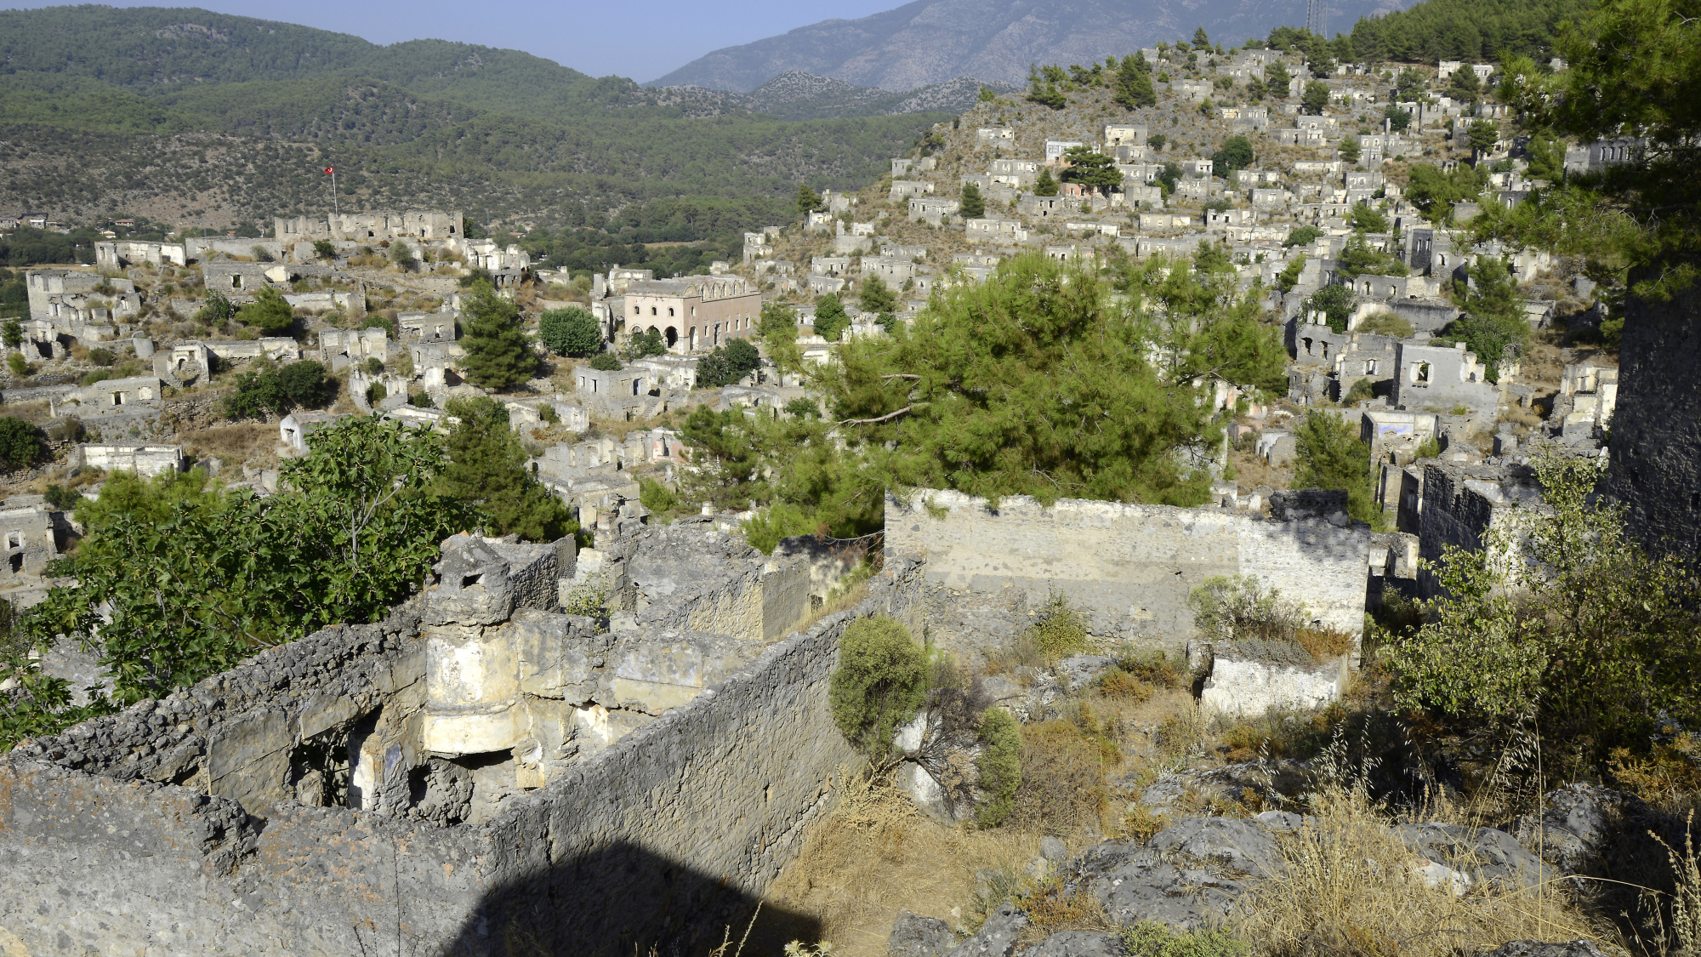
To Make Desolate...
And the ten horns which thou sawest upon the beast, these shall hate the whore, and shall make her desolate and naked, and shall eat her flesh, and burn her with fire.
This Photo by Unknown author is licensed under CC BY-NC.

Slide 22
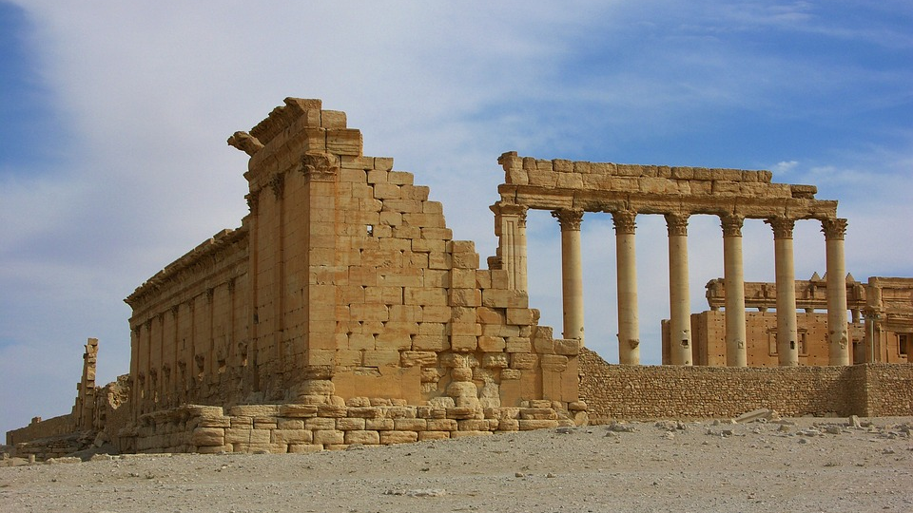
Definition of Desolate...
"Destitute or deprived of inhabitants; desert; uninhabited; denoting either stripped of inhabitants"
Websters 1828 Dict.

Slide 23
Policies Rejected...
Policy #1 Laudato Si'
A Papal encyclical on the universal care of the environment. (Climate action initiatives)
Excellent resource : Search YouTube What's Up Prof? #72
This Photo by Unknown author is licensed under CC BY-NC-ND.

Slide 24
European Farmers Revolt!
See Daniel 2:42-44 Ten toes... right at the end of time...

Slide 25
A List of Farmer Protests ahead of EU Elections:
Dutch
German
Italian
French
England
Ireland
Portugal
Poland
And now Canada!

Slide 26
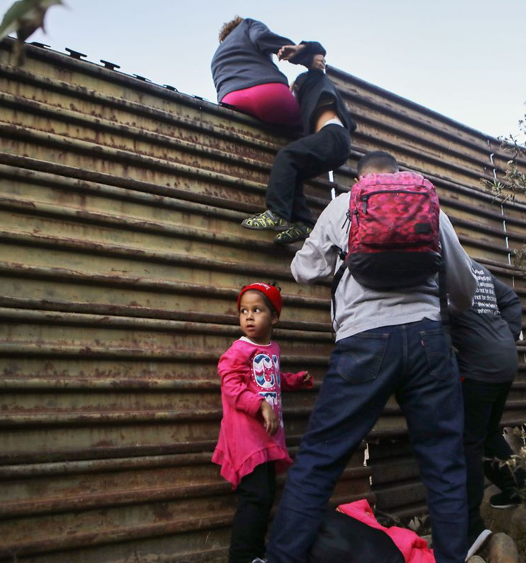
Policies Rejected...
Poilcy #2 Fratelli Tutti
Papal encyclical on the social order...
This Photo by Unknown author is licensed under CC BY-NC-ND.

Slide 27
Policies Rejected...
Poilcy #2 Fratelli Tutti
Papal encyclical on the social order...
Excellent resource;
What's Up Prof #35 on YouTube.
This Photo by Unknown author is licensed under CC BY-SA.

Slide 28
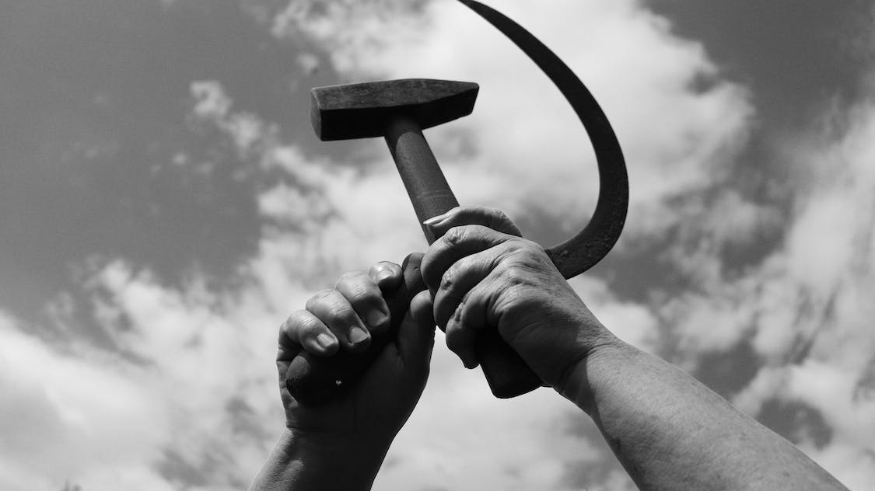
Policies Rejected...
Poilcy #2 Fratelli Tutti
Papal encyclical on the social order...
Excellent resource;
What's Up Prof #35 on YouTube.

Slide 29
No More time... Rev 10:5,6
And the angel which I saw stand upon the sea and upon the earth lifted up his hand to heaven... And sware by him that liveth for ever and ever, who created heaven, and the things that therein are, and the earth, and the things that therein are, and the sea, and the things which are therein, that there should be time no longer.

Slide 30
The Revelation Of Jesus!
The Revelation of Jesus Christ, which God gave unto him, to shew unto his servants things which must shortly come to pass Rev 1:1

Slide 31
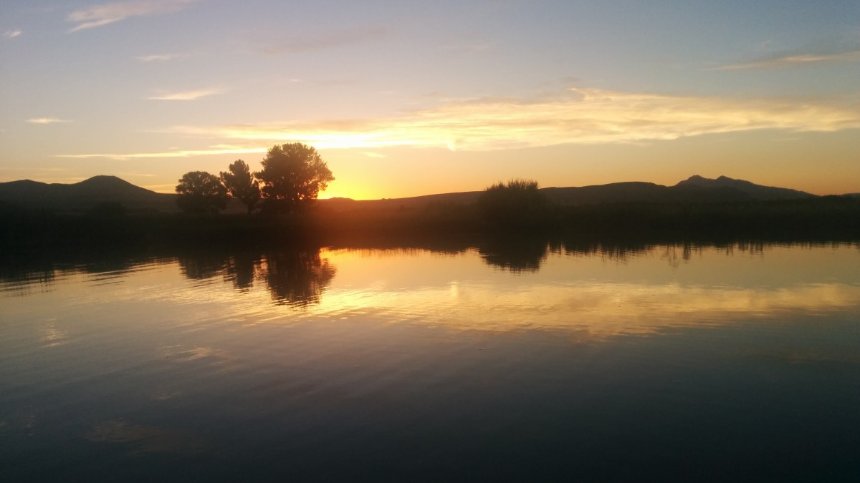
John 14:27-29
Peace I leave with you, my peace I give unto you: not as the world giveth, give I unto you. Let not your heart be troubled, neither let it be afraid... And now I have told you before it come to pass, that, when it is come to pass, ye might believe.

Slide 32
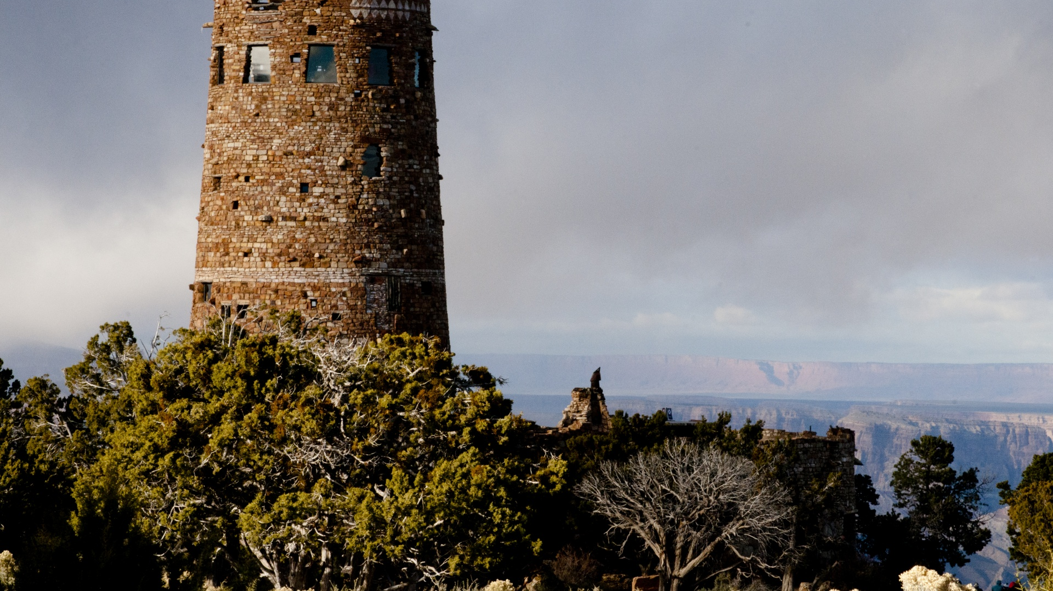
Watch! Mark 13:34-37
For the Son of man is as a man taking a far journey, who left his house, and gave authority to his servants, and to every man his work, and commanded the porter to watch. Watch ye therefore: for ye know not when the master of the house cometh, at even, or at midnight, or at the cockcrowing, or in the morning: Lest coming suddenly he find you sleeping. And what I say unto you I say unto all, Watch.

